Slide 1
Multiple Year Stock Data
CODE AND SCREENSHOTS

Slide 2
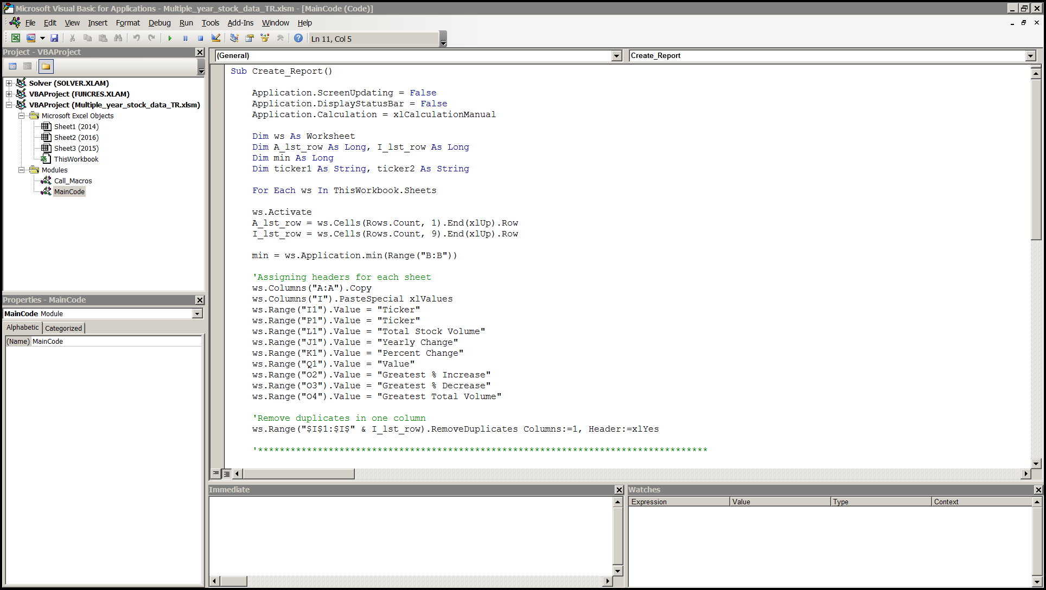
Create Report Macro Code Prt.1

Slide 3
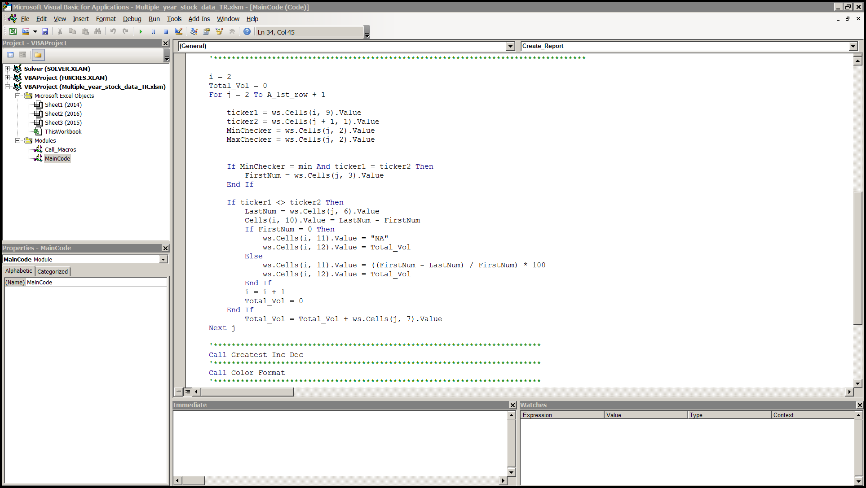
Create Report Macro Code Prt.2

Slide 4
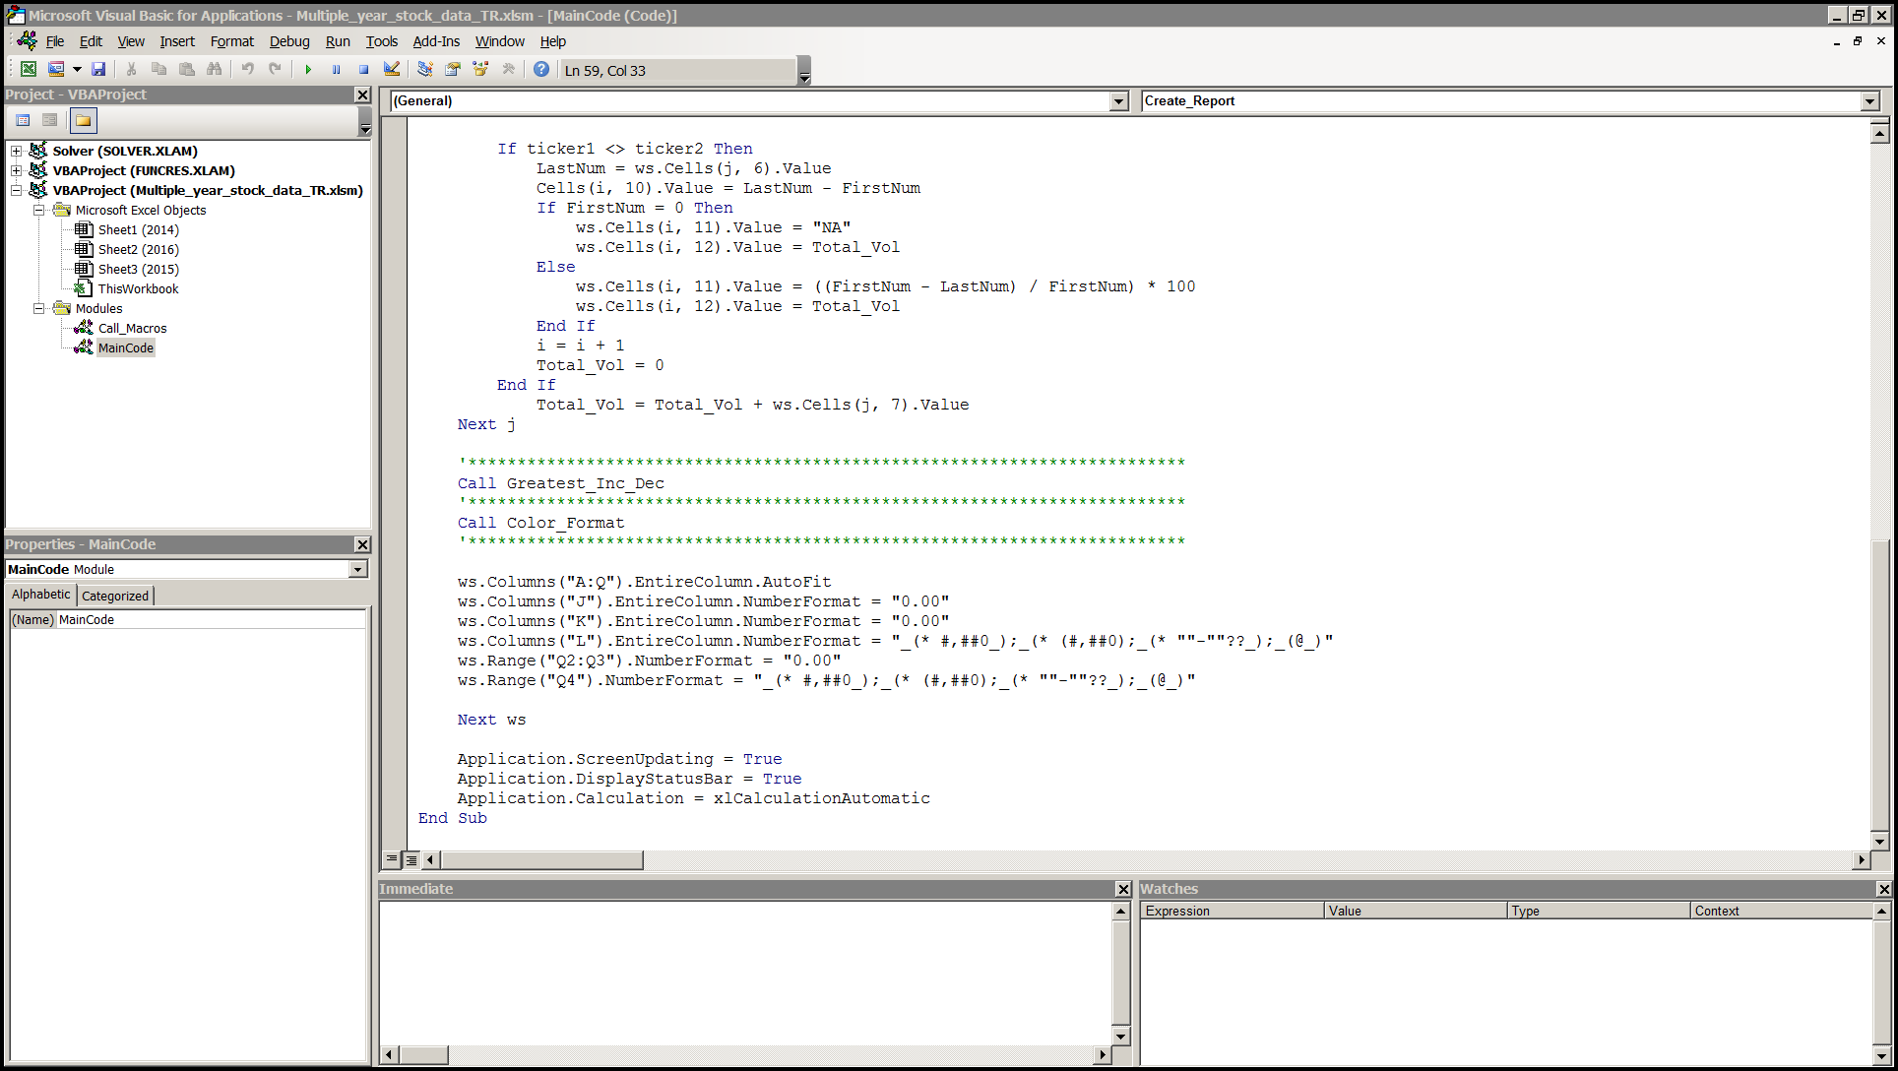
Create Report Macro Code Prt.3

Slide 5
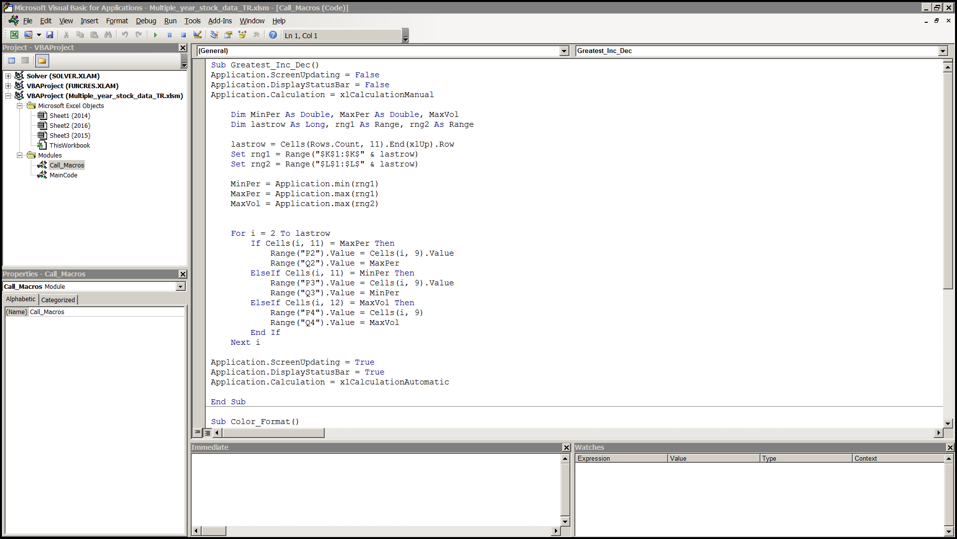
Greatest Increase Macro Code

Slide 6
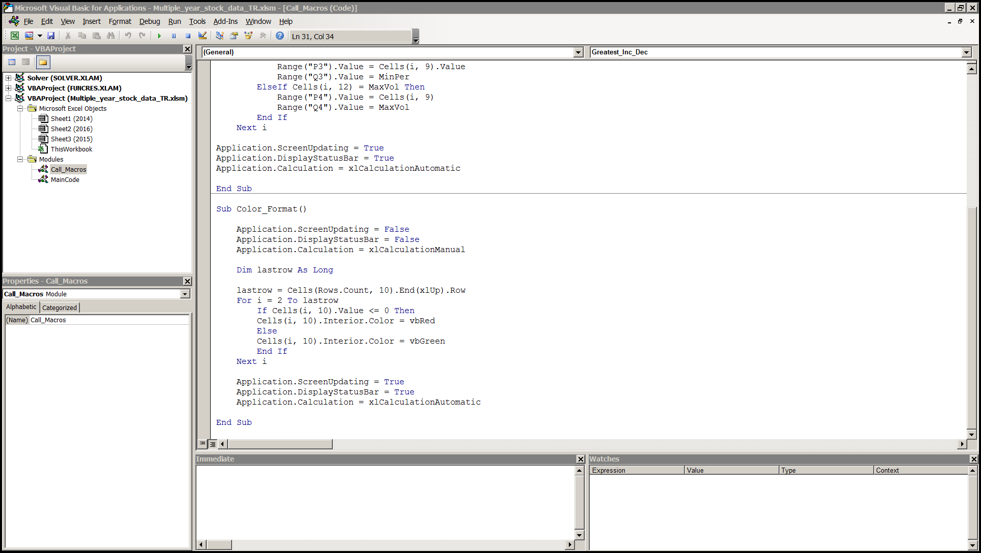
Color Formatting Code

Slide 7
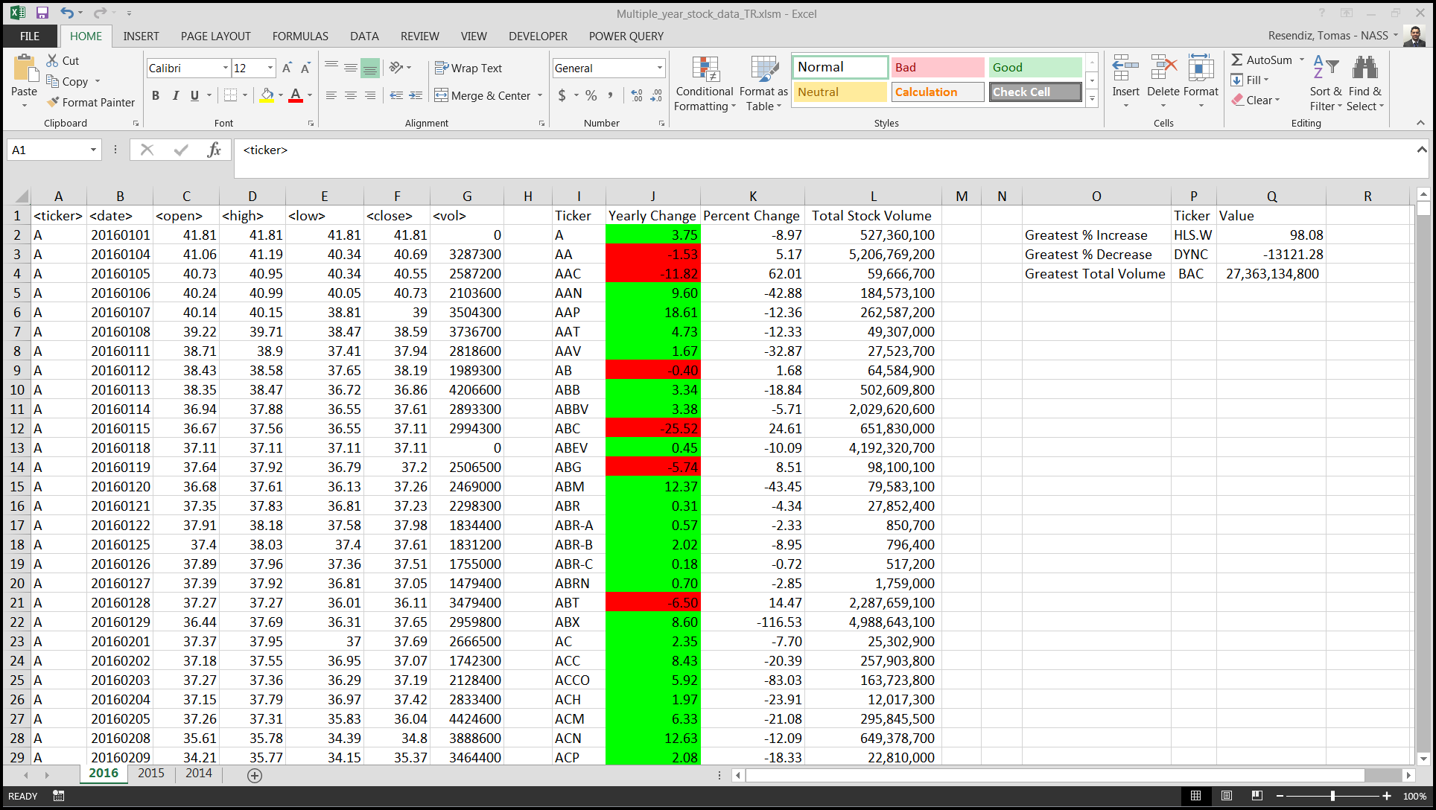

Slide 8
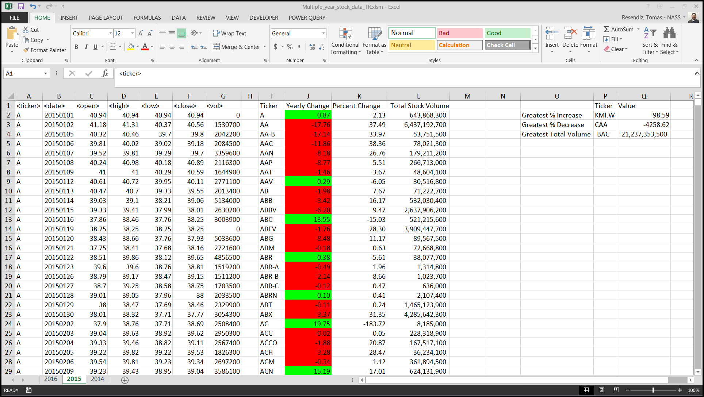

Slide 9
